Slide 1
L6 Group 6: IceBreaker
Samuel Cook
Anthony Brame
Robert Yearling
William Terry

Slide 2
Logline
Explore a ship as Birch Unravelling a dark secret held deep in the belly of the IceBreaker.

Slide 3
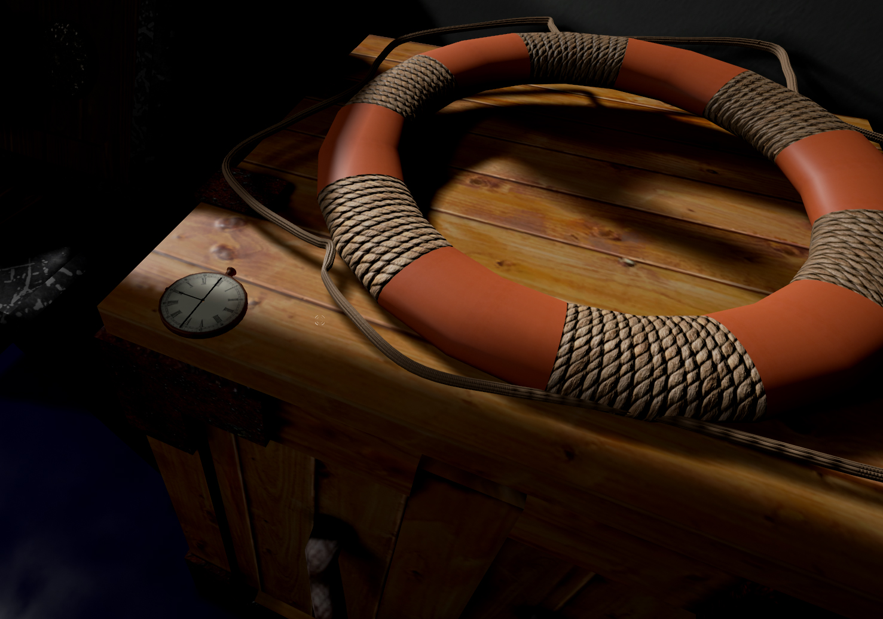

Slide 4
Demographic
Gender: Males
Age: 18 – 24 (Schell J, 2008)

Slide 5
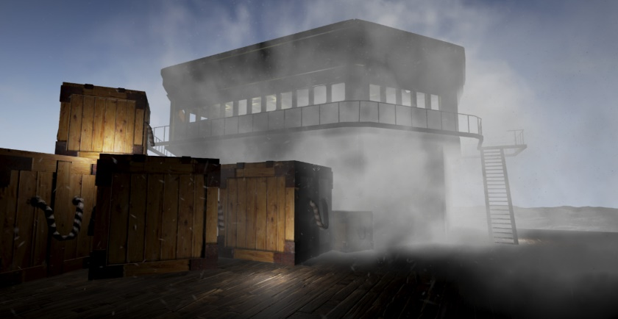
Concept
Theme: Fantasy horror Steam era 1920's
Story: Icebreaker Heading home from an arctic expedition to bring word of the discovery of an artifact, however will they make it home and if they do what will they unleash upon the world.
Entertainment though Atmosphere (Horror)
Entertainment though Thrills (Suspense)
(Phillips and Huntley, 2004)

Slide 6
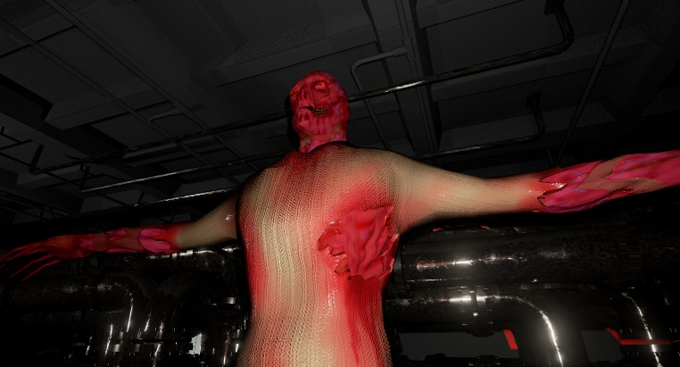
Unique Selling Points
Minimal use of non diegetic elements
Voice used to convey objectives (intercom)
Pocket watch system for player navigation and audio recording for in-game lore.

Slide 7
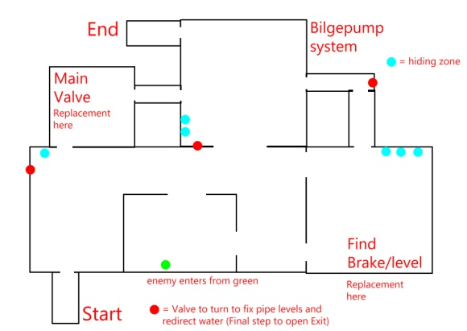
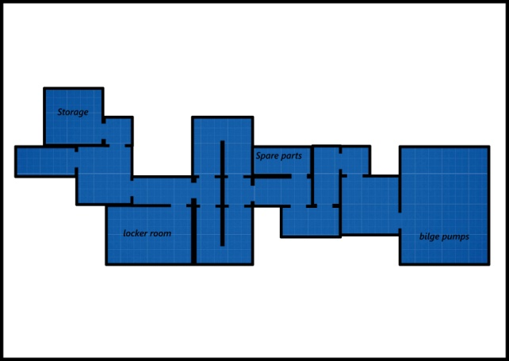
Level Design / Spatial Awareness and Logic Puzzle
Using spatial awareness, logic, timing and mechanic
Puzzles are broken up into bullet points of tasks, and then made around the level to be as diegetic to the game as possible (example bilge pump in bilge pump room, extra components in spare parts or storage, water dripping out of the pipes to indicate a valve has not been turned)
Puzzles are made with the environment and enemies in mind

Slide 8
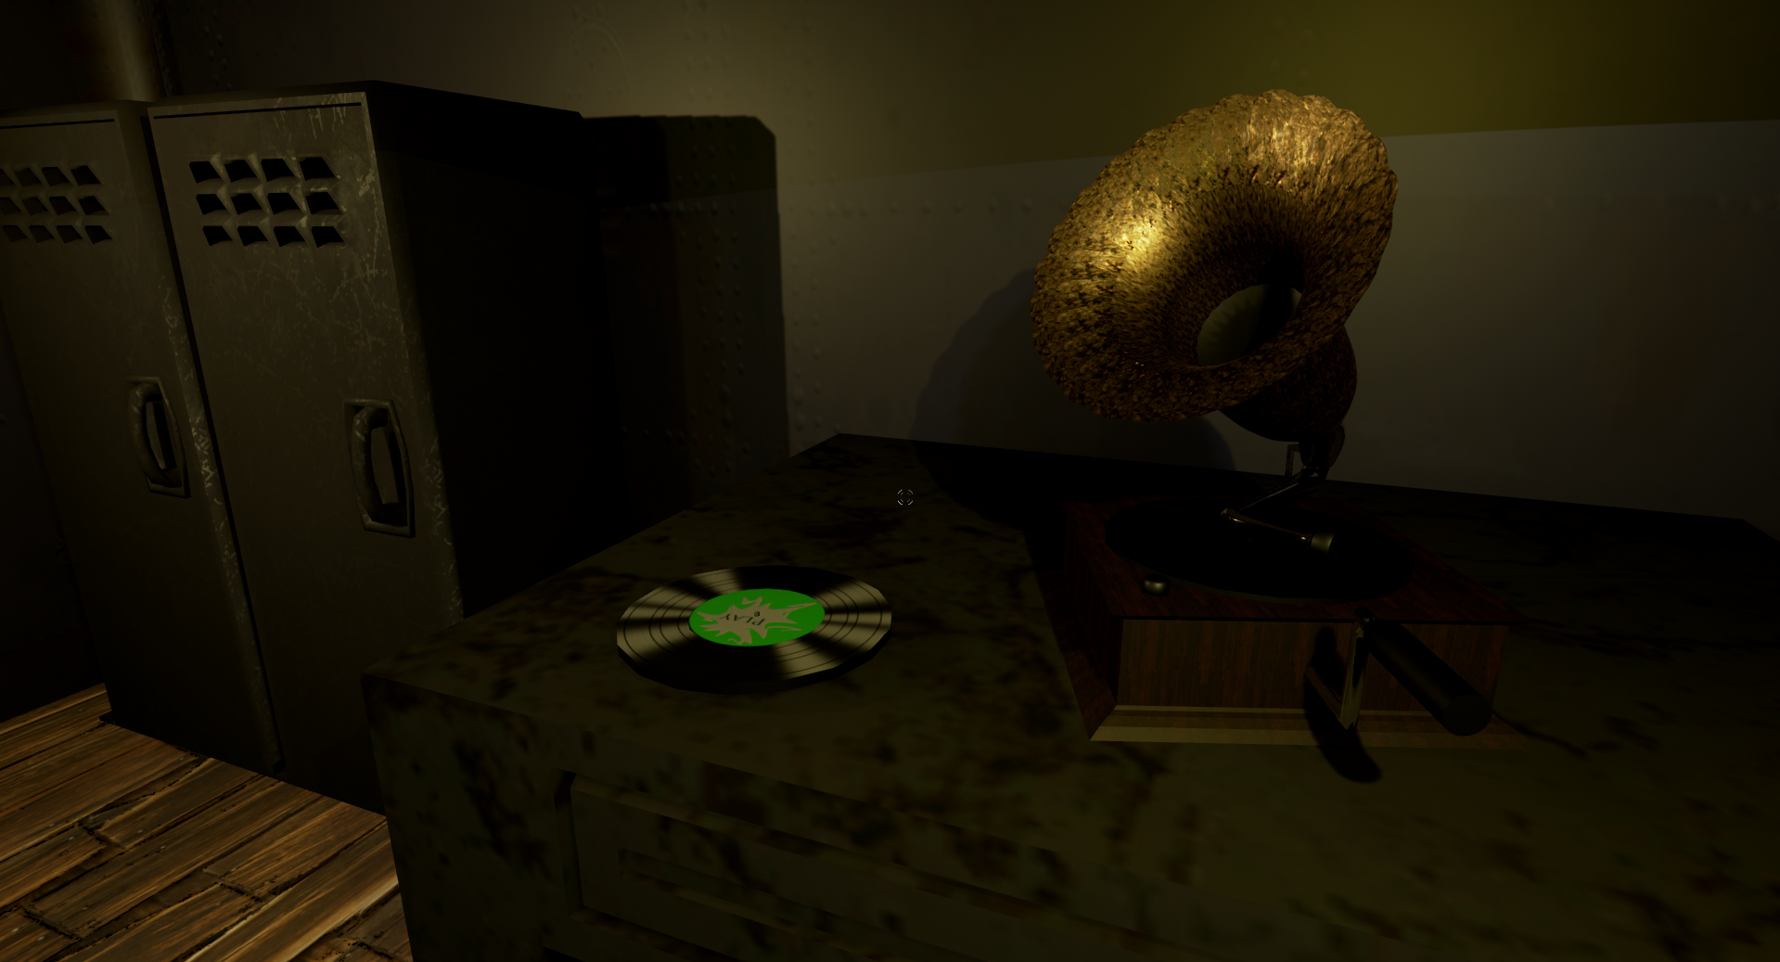

Slide 9
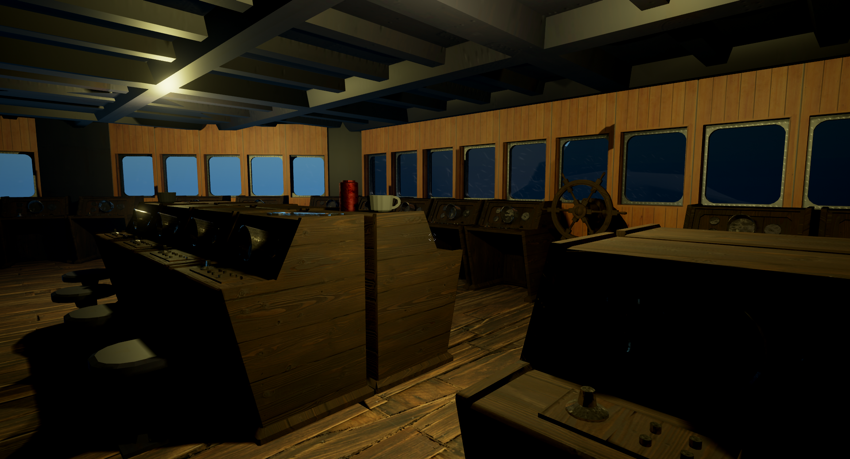

Slide 10
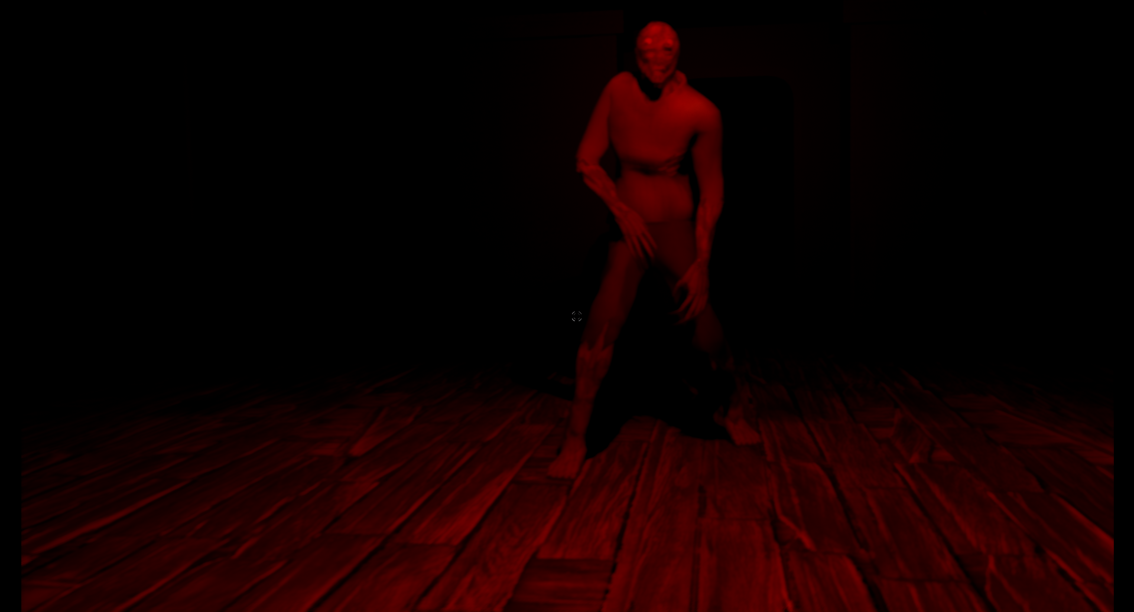

Slide 11
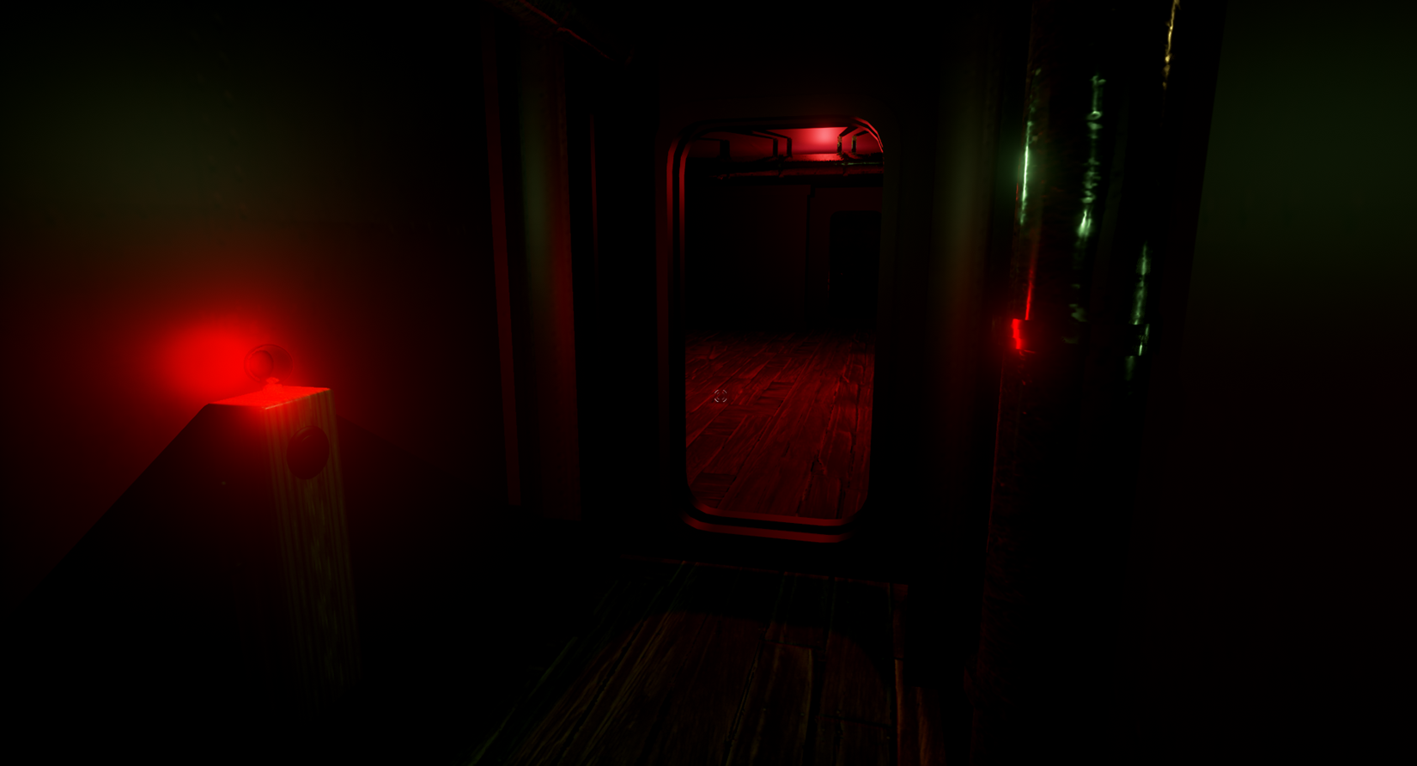

Slide 12
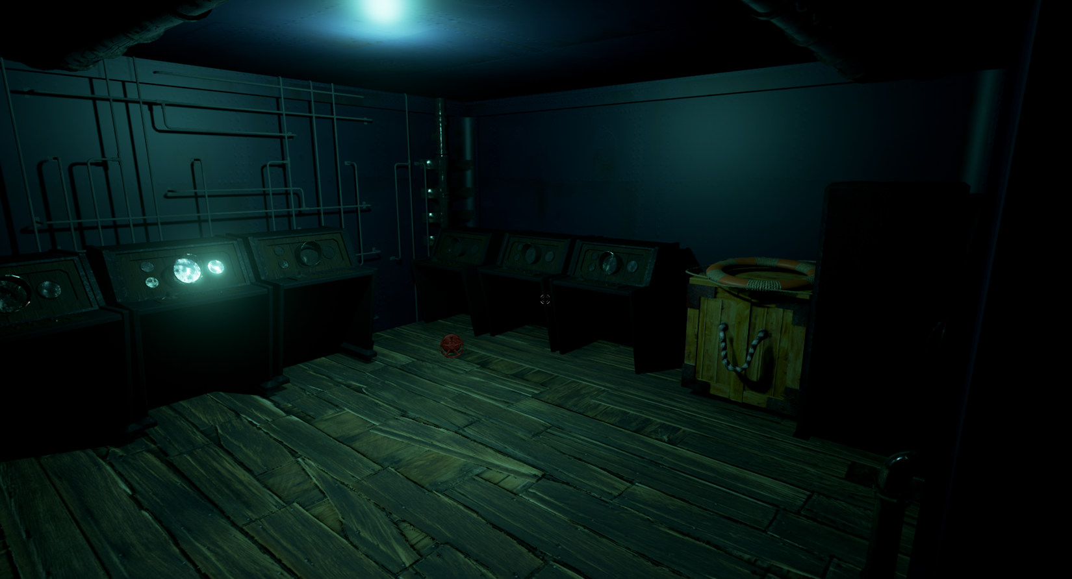

Slide 13
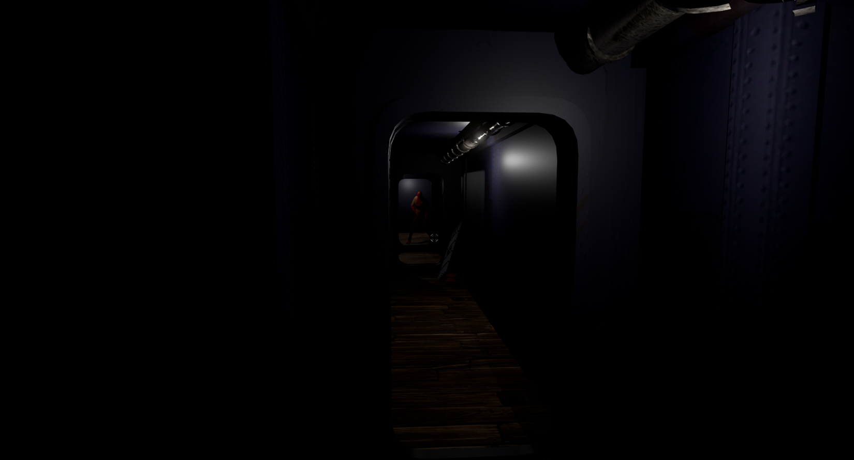

Slide 14
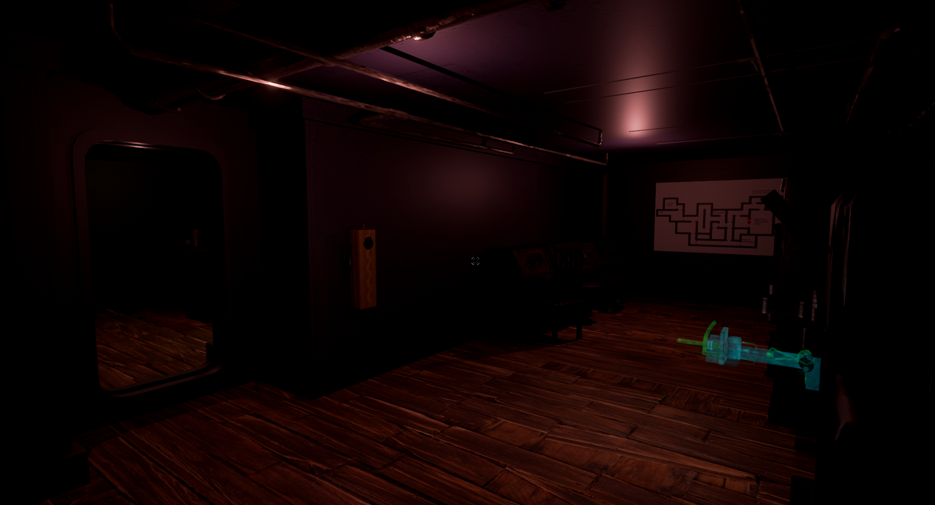

Slide 15
Gameplay
https://youtu.be/qAPLBQ8ToVo

Slide 16
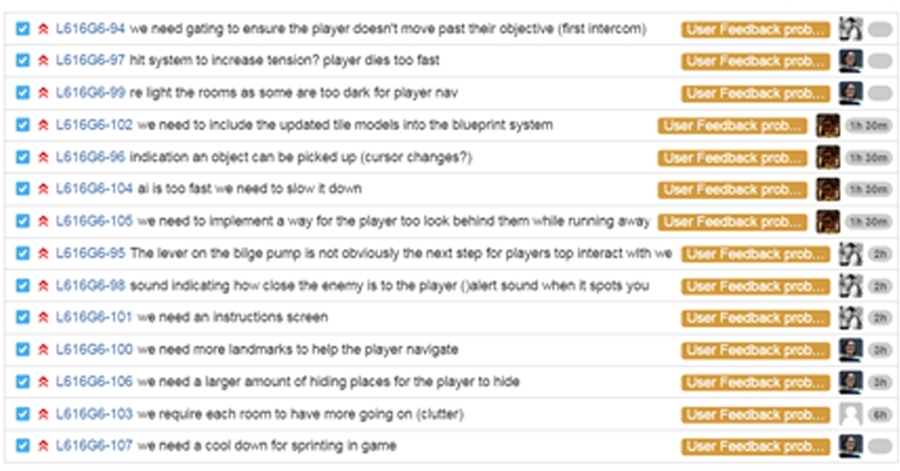
User Feedback & Solutions
https://youtu.be/e_e36ghaZYI
https://youtu.be/unam9Jt3LUs
https://youtu.be/9FwuU6HT82s
https://youtu.be/BO1PxjRBFQk
https://youtu.be/FPz1fvgDx8U
https://youtu.be/WZkHL-Qf5Ow
https://youtu.be/Ps6w7HE90SI
https://youtu.be/takHFWPpVW0
https://youtu.be/GztqwFqUo3c https://youtu.be/ln6A5y-BVLo
https://youtu.be/cwaFKp-vbWM
https://youtu.be/jtMutZwkwgw
https://youtu.be/ZQB6888cPDk
https://youtu.be/1WD5-Ks_Y4M

Slide 17
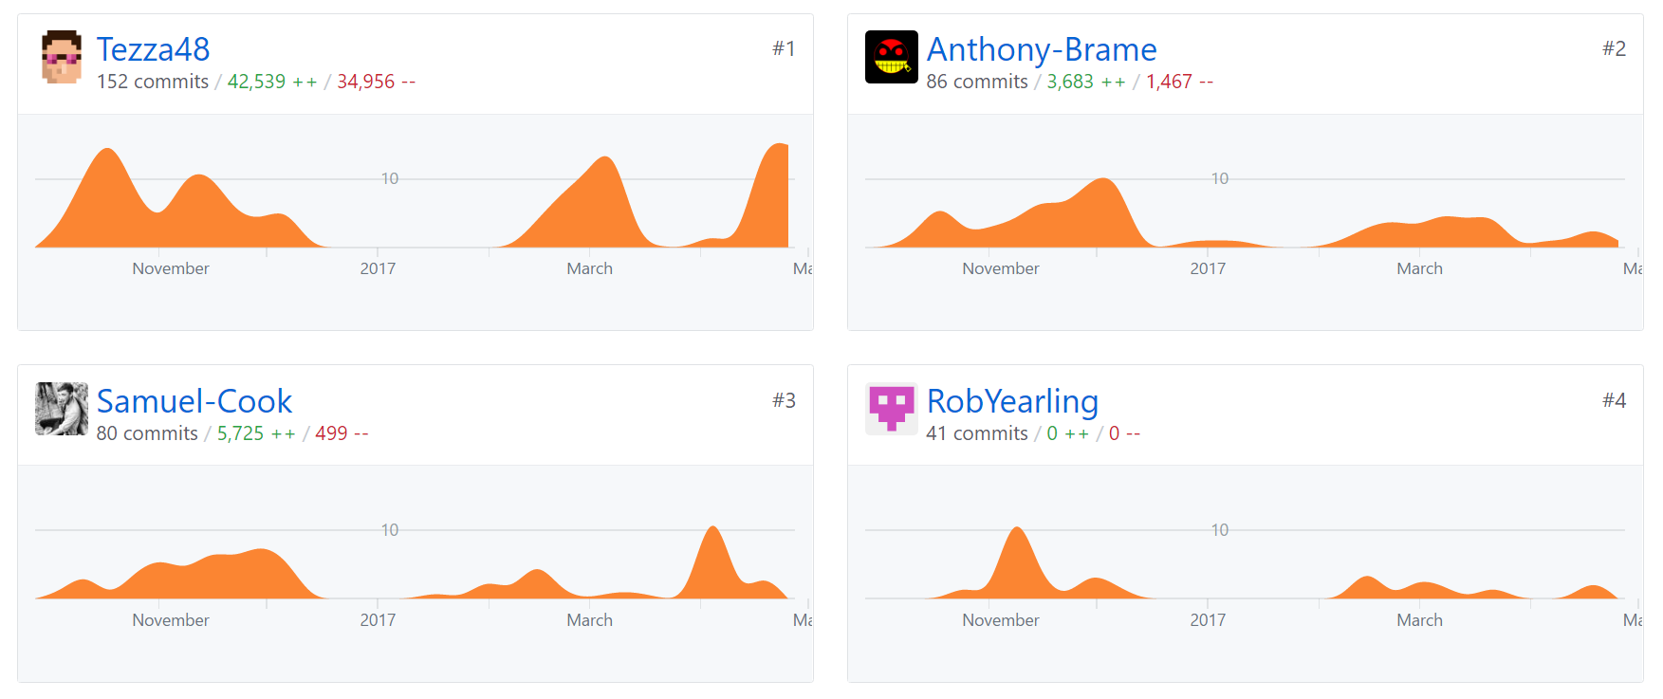
Management:
Commit total = 394

Slide 18
What we are taking from this project:
Building meaning into work as we go, from narrative, to gameplay, a level system is handy but if there is nothing to do in the level then the player is just exploring without meaning.
Scaling and scoping needs to be improved as well as communication between programming and art as hiccups happened through out the project

Slide 19
Thank you for listening , Any Questions?
References
Bartle, R. (1996) Richard A. Bartle: Players Who Suit MUDs, Mud.co.uk. Available at: http://mud.co.uk/richard/hcds.htm (Accessed: 17 October 2016).
Phillips, M. and Huntley, C. (2004) Dramatica. Glendale, Calif.: Write Brothers Press.
Schell, J. (2008) The art of game design. Amsterdam: Elsevier/Morgan Kaufmann.

